Slide 1

RC Primer: Incredibly Easy Parallelization with High Throughput Computing

Slide 2

Incredibly Easy Parallelization with High Throughput Computing
Contributors: Layla Freeborn, Trevor Hall, Andrew Monaghan, Brandon Reyes, Michael Schneider
Website: www.rc.colorado.edu/rc
Documentation: https://curc.readthedocs.io
Helpdesk: rc-help@colorado.edu
Survey: http://tinyurl.com/curc-survey18
Slides
https://github.com/ResearchComputing/easy_parallelization_htc_primer

Slide 3









Meet the User Support Team
Layla Freeborn
Brandon Reyes
Andy Monaghan
Michael Schneider
John
Reiland
Dylan Gottlieb
Mohal Khandelwal
Ragan
Lee

Slide 4
Learning Objectives and Outline
Introduction to high throughput computing (HTC)
HTC Tools
Structuring Data for HTC
Open Science Grid

Slide 5
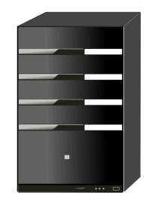
What is High Throughput Computing (HTC)?
Task
Task
Task
Task
Task
Task
Independent Work
(Loosely Coupled)
Dependent Work (Highly Coupled)
This is HTC!

Slide 6


Concept Review – Is It High Throughput?
Workflow A
Workflow B
Analyze a collection of medical records to identify patients most at risk for heart disease.
Analyze atmospheric data to simulate and forecast weather conditions over a large geographic area.

Slide 7
Starter Script – Low Throughput
CODE
DATA
import sys
car=sys.argv[1]
mpg=sys.argv[2]
print("The " + car + " gets " + mpg + " mpg.")
mustang 25
pinto 30
chevette 33
nova 21
cutlass 23
The mustang gets 25 mpg.
The pinto gets 30 mpg.
[…]

Slide 8
Does it Scale?
If 1 task takes 30 minutes to finish, how well does the current script scale?
5 tasks?
5,000 tasks?
5 Million tasks?

Slide 9


Three HTC Methods
4"
4"
4"
Slurm Job Arrays
Load Balancer
GNU Parallel
Scaling Up
Big Jobs
Built-In
Resource Manager
Replaces
For-Loops
Notes:
Quick overview of the three options – Job array, GNU Parallel, Load Balancer
TODO: Improve the slide design and flow.
Idea – have the “main benefit” be placed outside of the square to prevent crowding of content

Slide 10

What is a Batch Job?
#!/bin/bash
#SBATCH --nodes=1
#SBATCH --ntasks=1
#SBATCH --time=00:10:00
#SBATCH --partition=atesting
#SBATCH --qos=testing
#SBATCH --output=sample-%j.out
…
Compute
Nodes
Batch Job
Notes:
Batch Job, Slurm, Node, Ntask/Core/CPU <- Worker

Slide 11
SLURM Job Array
4"
Slurm Job Arrays
Scaling Up
Big Jobs
Notes:
Graphical representation for having a manager that keeps each CPU worker working on an assigned task
Graphical Representation

Slide 12



Slurm Job Array - Overview
Batch Job
Job Array

Slide 13
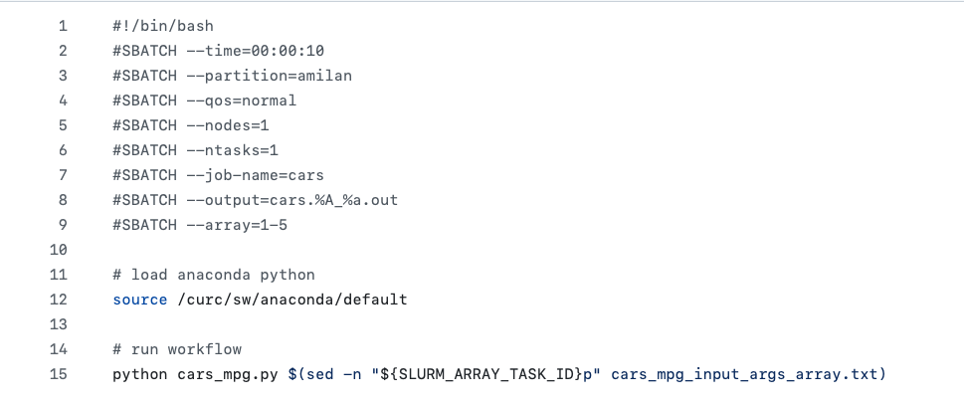
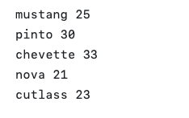
SLURM Job Arrays - Implementation
cars_mpg_array.sh (job script)
#SBATCH --array=START-STOP
#SBATCH --ntasks=Cores per
#SBATCH --nodes=Nodes per
cars_mpg_args_array.txt
(arguments)
$SLURM_ARRAY_TASK_ID → 1 - 5
Notes:
sinteractive --partition=atesting --qos=testing --time=90:00 --ntasks=1

Slide 14
Load Balancer
4"
Load Balancer
Built-In
Resource Manager
Notes:
Graphical representation for having a manager that keeps each CPU worker working on an assigned task
Graphical Representation

Slide 15
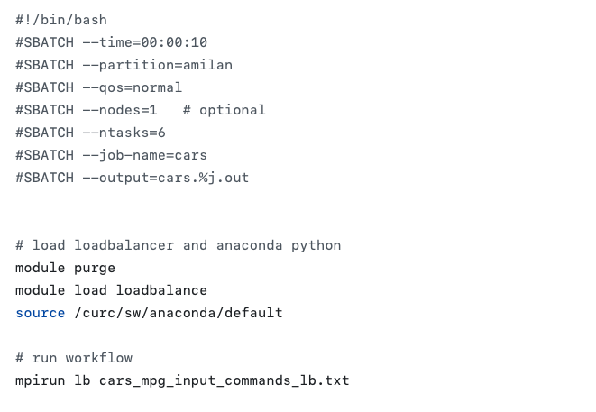
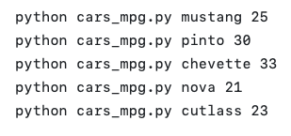
Method 2 Example: Load Balancer
cars_mpg_lb.sh (job script)
# Workers = ntasks - 1
Request resources for all members
cars_mpg_commands_lb.txt
(arguments)
Load the ‘loadbalance’ module
Notes:
sinteractive --partition=atesting --qos=testing --time=90:00 --ntasks=1
Loadbalancer – can run across nodes?
The manager will ensure additional tasks are handled by the primary core.

Slide 16
GNU Parallel
4"
GNU Parallel
Replaces
For-Loops
Notes:
Graphical representation for having a manager that keeps each CPU worker working on an assigned task
Graphical Representation

Slide 17
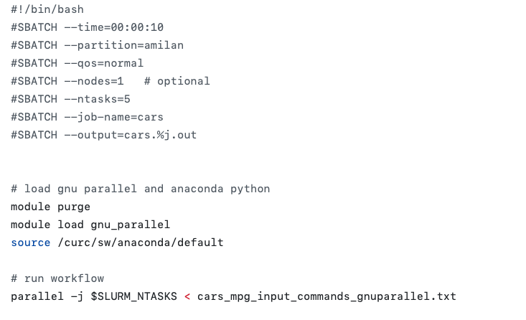
Method 3 Example: GNU Parallel
cars_mpg_gnuparallel.sh (job script)
# Workers = ntasks
Tasks Split Evenly
Request resources for all members
cars_mpg_commands_gnuparallel.txt
(arguments)
Load the ‘gnu_parallel’ module

Slide 18
Three HTC methods for Alpine
 | Job Arrays | Load Balancer | GNU Parallel
Job length? | > 10 min | < 30 min | < 30 min
Notes:
Also – animate rows

Slide 19
Three HTC methods for Alpine
 | Job Arrays | Load Balancer | GNU Parallel
Job length? | > 10 min | < 30 min | < 30 min
Where can I use? | Alpine, SLURM HPC | Alpine | Alpine, Local Computer
Notes:
Also – animate rows

Slide 20
Three HTC methods for Alpine
 | Job Arrays | Load Balancer | GNU Parallel
Job length? | > 10 min | < 30 min | < 30 min
Where can I use? | Alpine, SLURM HPC | Alpine | Alpine, Local Computer
Max jobs in queue? | 1000* | - | -
*Depends on QOS
Notes:
Also – animate rows

Slide 21
Three HTC methods for Alpine
 | Job Arrays | Load Balancer | GNU Parallel
Job length? | > 10 min | < 30 min | < 30 min
Where can I use? | Alpine, SLURM HPC | Alpine | Alpine, Local Computer
Max jobs in queue? | 1000* | - | -
Supports Multi-Node? | Yes | Yes | Yes – but not well
*Depends on QOS
Notes:
Also – animate rows

Slide 22
Three HTC methods for Alpine
 | Job Arrays | Load Balancer | GNU Parallel
Job length? | > 10 min | < 30 min | < 30 min
Where can I use? | Alpine, SLURM HPC | Alpine | Alpine, Local Computer
Max jobs in queue? | 1000* | - | -
Supports Multi-Node? | Yes | Yes | Yes – but not well
Max cores per task? | None | None – Usually 1 | None – Usually 1
*Depends on QOS
Notes:
Also – animate rows

Slide 23
Three HTC methods for Alpine
 | Job Arrays | Load Balancer | GNU Parallel
Job length? | > 10 min | < 30 min | < 30 min
Where can I use? | Alpine, SLURM HPC | Alpine | Alpine, Local Computer
Max jobs in queue? | 1000* | - | -
Supports Multi-Node? | Yes | Yes | Yes – but not well
Max cores per task? | None | None – Usually 1 | None – Usually 1
Does it reserve a controller core? | No | Yes | No
*Depends on QOS
Notes:
Also – animate rows

Slide 24
Three HTC methods for Alpine
 | Job Arrays | Load Balancer | GNU Parallel
Job length? | > 10 min | < 30 min | < 30 min
Where can I use? | Alpine, SLURM HPC | Alpine | Alpine, Local Computer
Max jobs in queue? | 1000* | - | -
Supports Multi-Node? | Yes | Yes | Yes – but not well
Max cores per task? | None | None – Usually 1 | None – Usually 1
Does it reserve a controller core? | No | Yes | No
Primary Focus? | Managing jobs | Manages Resources Across Nodes (MPI-Lite) | Replaces Loops
*Depends on QOS
Notes:
Also – animate rows

Slide 25

Structuring Data
Files & Directories
Inputs & Parameters
Notes:
Generic 1 – Organizing data files
Generic 2 – Generating an input file

Slide 26

Structuring Files & Directories
1/
file1.txt
2/
file2.txt
data/
n/
filen.txt
/scratch/alpine/$USER/data/n/filen.txt

Slide 27
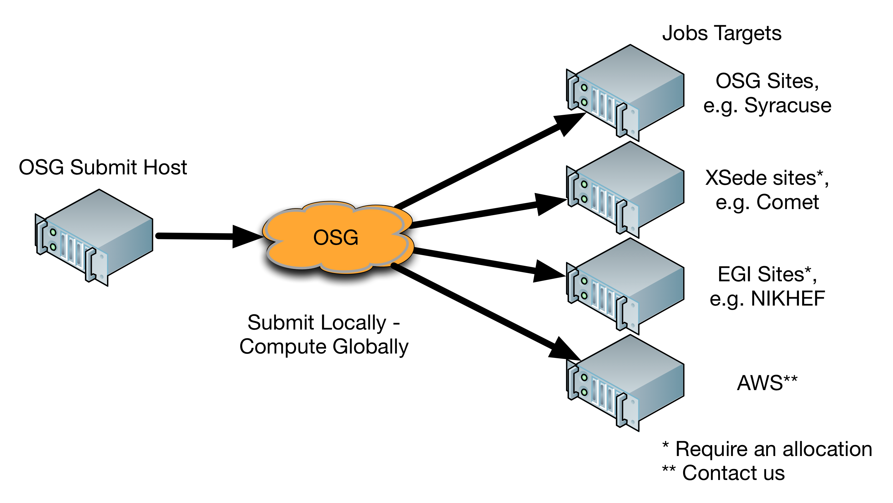
A Community HTC Resource beyond Alpine: Open Science Grid (OSG)
NSF/DOE-funded service (free!)
Open to any U.S.-based researcher
125 institutions sharing spare computing cycles
~1 Billion core hours per year used
Can get started quickly. Options for dedicated allocation if needed.
https://osgconnect.net
Source: https://swc-osg-workshop.github.io/OSG-UserTraining-JLab-2019/materials/AHM/01-IntroGrid.html

Slide 28

Thank you!
http://tinyurl.com/curc-survey18
Survey and feedback

